Slide 1


Java Collection Framework

Slide 2
Java Collection Framework:
Definition:
A Collection is a group of individual objects represented as a single unit. Java provides Collection Framework which defines several classes and interfaces to represent a group of objects as a single unit.
Problem Before Collection Framework

Slide 3
Advantage of Collection:
Consistent API : The API has basic set of interfaces like Collection, Set, List, or Map. All those classes (such as ArrayList, LinkedList, Vector etc) which implements, these interfaces have some common set of methods.
Reduces programming effort: The programmer need not to worry about design of Collection rather than he can focus on its best use in his program.
Increases program speed and quality: Increases performance by providing high-performance implementations of useful data structures and algorithms.

Slide 4
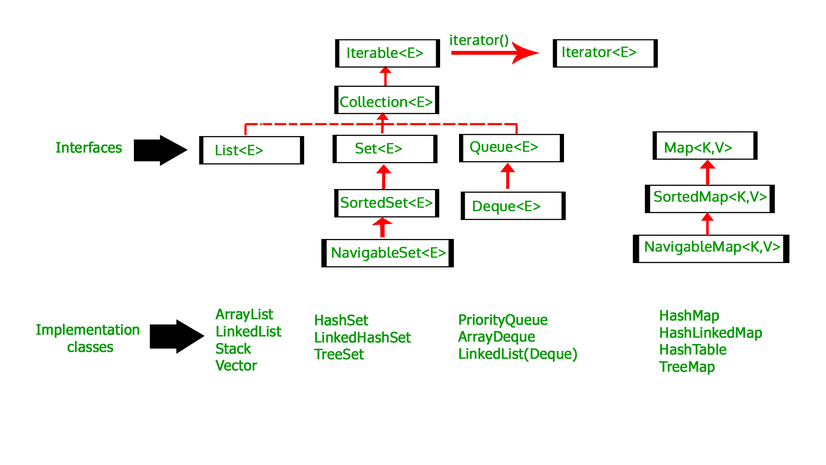
Collection Framework Hierarchy:

Slide 5


